Slide 1

LECTURE 5
O P T I M I Z AT I O N , D ATA
M A N I P U L AT I O N , L I F E C Y C L E
DANIEL R YS JAN VÁCL AVÍK

Slide 2
O V E R V I E W
Optimization
Callbacks
Promises
Angular resource ($resource)
Life cycle
Generate splash screen and icons
Google Analytics

Slide 3
O P T I M I Z AT I O N

Slide 4
O P T I M I Z AT I O N
Who noticed that the homework was slow?

Slide 5
O P T I M I Z AT I O N
Who noticed that the homework was slow?
Who of you has Android?

Slide 6

O P T I M I Z AT I O N
Who noticed that the homework was slow?
Hardly coincidence!
Who of you has Android?

Slide 7
W H AT W E C A N O P T I M I Z E
Native scroll
Collection repeat
Track by
One time data binding
Crosswalk

Slide 8
W H AT W E C A N O P T I M I Z E
Native scroll
Android only
Collection repeat
Track by
One time data binding
Crosswalk

Slide 9



W H AT W E C A N O P T I M I Z E
Native scroll
Collection repeat
Track by
Not works with native scroll and one time data binding
One time data binding
Crosswalk

Slide 10
W H AT W E C A N O P T I M I Z E
Native scroll
Collection repeat
Track by
Works everywhere
One time data binding
Crosswalk

Slide 11

W H AT W E C A N O P T I M I Z E
Native scroll
Collection repeat
Track by
One time data binding
Works everywhere
Crosswalk

Slide 12
W H AT W E C A N O P T I M I Z E
Native scroll
Collection repeat
Track by
One time data binding
Crosswalk
Android only

Slide 13
N AT I V E S C R O L L
Greatly increasing scrolling smoothness
Works only for Android platform
For enable native scroll, disable Javascript scrolling

Slide 14
S E T N AT I V E S C R O L L G L O B A L LY
www/app/routes.js
app.config(function($ionicConfigProvider,...){
...
$ionicConfigProvider.scrolling.jsScrolling(false);
...
}

Slide 15
S E T N AT I V E S C R O L L F O R V I E W
<ion-content overflow-scroll="true">
...
</ion-content>

Slide 16
C O L L E C T I O N R E P E AT
Collection-repeat allows an app to show huge lists of items
much more performantly than ng-repeat
Renders into the DOM only as many items as are currently visible
Doesn’t have native scroll
Only for arrays
Fixed height
Inspired by iOS’s UITableView

Slide 17
C O L L E C T I O N R E P E AT
<ion-list>
<ion-item collection-repeat="movie in data.movies">
{{movie.title}}
</ion-item>
</ion-list>

Slide 18
T R A C K B Y
Use for avoid useless DOM manipulation
<ion-list>
<ion-item ng-repeat="movie in movies track by movie.id">
{{movie.title}}
</ion-item>
<ion-item ng-repeat="movie in movies track by $index">
{{movie.title}}
</ion-item>
</ion-list>

Slide 19

T R A C K B Y
Use for avoid useless DOM manipulation
If items have unique ID
<ion-list>
<ion-item ng-repeat="movie in movies track by movie.id">
{{movie.title}}
</ion-item>
<ion-item ng-repeat="movie in movies track by $index">
{{movie.title}}
</ion-item>
</ion-list>

Slide 20

T R A C K B Y
Use for avoid useless DOM manipulation
If items have unique ID
<ion-list>
<ion-item ng-repeat="movie in movies track by movie.id">
{{movie.title}}
</ion-item>
<ion-item ng-repeat="movie in movies track by $index">
{{movie.title}}
</ion-item>
</ion-list>
If item’s don’t have unique ID

Slide 21

O N E T I M E D ATA B I N D I N G
Data does not get synchronized from view to controller
Don’t use angular one-time binding with collection- repeat
<ion-list>
<ion-item ng-repeat="movie in movies">
{{::movie.title}}
</ion-item>
</ion-list>
“::” is where the magic happens

Slide 22
C R O S S W A L K

Slide 23
C R O S S W A L K
Replacing native browser with Chromium–based
Useful for older Android devices with Android browser (Android < 4.4)
Significantly better performance and CSS support
https://crosswalk-project.org

Slide 24
A D D / R E M O V E C R O S S W A L K
$ ionic browser add crosswalk
$ ionic browser rm crosswalk

Slide 25
C A L L B A C K S

Slide 26
C A L L B A C K S
Function
Passed as argument to another function
Called after some event or action

Slide 27
C A L L B A C K S
function getMoviesFromApi(callback){
// Do something callback();
}
getMoviesFromApi(function(){ console.log("Hello!")
})

Slide 28

C A L L B A C K S
function getMoviesFromApi(callback){
// Do something callback();
}
getMoviesFromApi(function(){ console.log("Hello!")
})
Anonymous callback
function(){ console.log("Hello!")
}

Slide 29
C A L L B A C K S
function getMoviesFromApi(callback){
// Do something
callback();
}
getMoviesFromApi(function(){ console.log("Hello!")
})
Call callback function
Anonymous callback
function(){ console.log("Hello!")
}

Slide 30
C A L L B A C K S
function getMoviesFromApi(callback){
// Do something callback();
}
function sayHello(){ console.log("Hello!")
}
getMoviesFromApi(sayHello)

Slide 31

C A L L B A C K S
function getMoviesFromApi(callback){
// Do something callback();
}
function sayHello(){ console.log("Hello!")
}
getMoviesFromApi(sayHello)
Named function callback
sayHello

Slide 32
C A L L B A C K S
function getMoviesFromApi(callback){
// Do something
var name = "Katka"; callback(name);
}
function sayHelloTo(somebody){ console.log("Hello!" + somebody)
}
getMoviesFromApi(sayHello)

Slide 33

C A L L B A C K S
function getMoviesFromApi(callback){
// Do something
var name = "Katka"; callback(name);
}
Callback
with parameter
function sayHelloTo(somebody){ console.log("Hello!" + somebody)
}
getMoviesFromApi(sayHello)

Slide 34
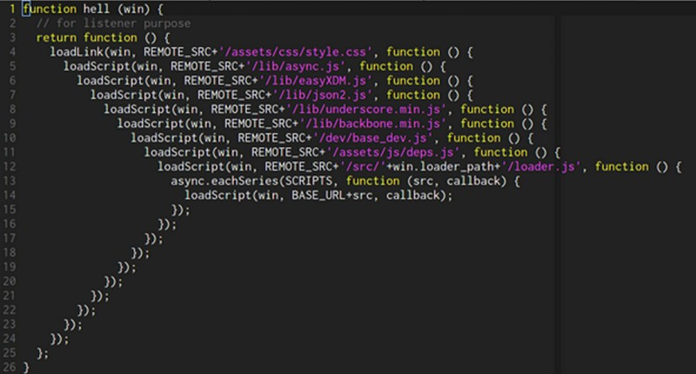
C A L L B A C K H E L L

Slide 35
P R O M I S E S

Slide 36
P R O M I S E S
Object for execution of asynchronous code
Represents an operation which is not completed yet (in EcmaScript 5 standard), but it’s expected
3 states – Pending, Fulfilled (resolved), Rejected

Slide 37
S TAT E S I N P R O M I S E
Pending
In progress
Initial state
Fulfilled
Finished with success
Rejected
Finished without success

Slide 38
P R O M I S E E X A M P L E ( A N G U L A R )
var promise = $http(request);
var success = function (response) { service.data.movies = response.results
};
var error = function (response) { console.error("error");
}
promise.then(success, error);

Slide 39

P R O M I S E E X A M P L E ( A N G U L A R )
var promise = $http(request);
var success = function (response) { service.data.movies = response.results
};
var error = function (response) { console.error("error");
}
promise.then(success, error);
“Then” calls callback when request is complete. Returns promise.

Slide 40
P R O M I S E E X A M P L E ( A N G U L A R )
Then()
Called when request is complete with success
Catch()
Called when request is complete without success
Finally()
Called when request is complete

Slide 41
P R O M I S E S V S . C A L L B A C K S

Slide 42
P R O M I S E S V S . C A L L B A C K S
Promise
Object
Mainly for asynchronous operations
Chaining
Callback
Function
Both synchronous/asynchronous operations
Nesting

Slide 43
H T T P R E Q U E S T / R E S P O N S E

Slide 44
H T T P R E Q U E S T – R E S P O N S E
Client
Server

Slide 45
H T T P R E Q U E S T – R E S P O N S E
Client
Server
Give me index.html

Slide 46
H T T P R E Q U E S T – R E S P O N S E
Client
Server
Give me index.html
Here you are

Slide 47

H T T P R E Q U E S T – R E S P O N S E
Request
Client
Server
Give me index.html
Here you are

Slide 48
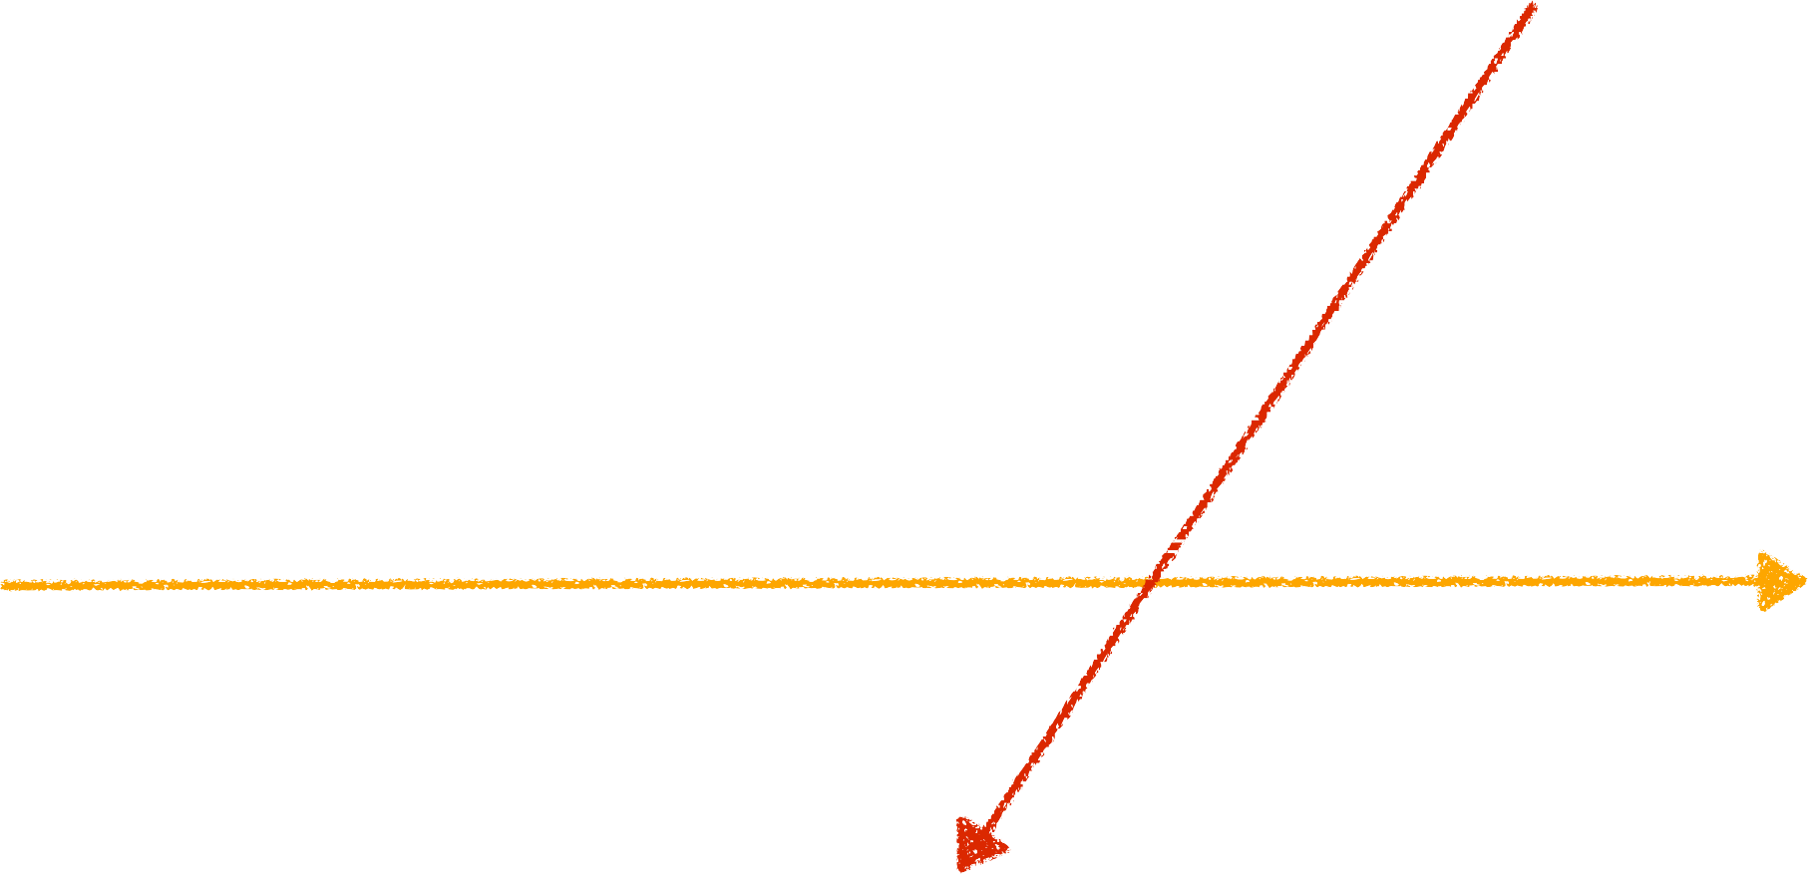
H T T P R E Q U E S T – R E S P O N S E
Request
Response
Client
Server
Give me index.html
Here you are

Slide 49
H T T P R E Q U E S T
Client requests for some data
Headers
Many formats: Content type (JSON, XML, form data,
…)
Body
Many types: GET, POST, PUT, DELETE,…

Slide 50
H T T P R E S P O N S E
Server gives us data in specified format
Headers
Meta information
Body
Data which we requested

Slide 51
R E S T P R I N C I P L E
URL – some entity (data resource) we want to interact with
Methods – what we want to do with entity
Example 1: I want to get movies
URL: http://movies.com/api/movies
Method: GET

Slide 52
H T T P M E T H O D S I N R E S T
Methods used for specific operations
GET – get some data (request is without body)
POST – create new data
PUT – update some data
DELETE – delete some data

Slide 53
R E S T E X A M P L E S
Example 2: I want to get a single movie with ID 6
URL: http://movies.com/api/movies/6
Method: GET

Slide 54
R E S T E X A M P L E S
Example 3: I want to add rating for movie with ID 6
URL: http://movies.com/api/movies/6/rating
Method: POST

Slide 55
R E S T E X A M P L E S
Example 4: I want update movie info with ID 6
URL: http://movies.com/api/movies/6
Method: PUT

Slide 56
R E S T E X A M P L E S
Example 5: I want delete movie info with ID 6
URL: http://movies.com/api/movies/6
Method: DELETE

Slide 57
H T T P S TAT U S C O D E S
Every response returns status code
Next operations can be based on returned status code
Numbers between 100 - 505

Slide 58
H T T P S TAT U S C O D E S
1.. – Informational
2.. – Success
3.. – Redirect
4.. – Client error
5.. – Server error

Slide 59
A N G U L A R R E S O U R C E ( $ R E S O U R C E )

Slide 60
$ R E S O U R C E
Designed to use REST API
Angular object for manipulation with data
Has predefined methods mapped to REST operations
More abstract than $http (produce cleaner code)

Slide 61
$ R E S O U R C E M E T H O D S
get (GET one)
save (POST)
query (GET all)
delete (DELETE)

Slide 62
I N C L U D E $ R E S O U R C E
www/app/app.js
var app = angular.module('App', ['ionic', 'ui.router', 'ngResource']);

Slide 63
$ R E S O U R C E E X A M P L E
Example 1: I want to get movies
URL: http://movies.com/api/movies
Method: GET
$resource("http://movies.com/api/movies").query();

Slide 64
$ R E S O U R C E E X A M P L E
Example 2: I want to get a single movie with ID 6
URL: http://movies.com/api/movies/6
Method: GET
$resource( "http://movies.com/api/movies/:movieId",
{movieId: "@movieId"}
).get({movieId: 6});

Slide 65
$ R E S O U R C E E X A M P L E
Example 3: I want to add rating for movie with ID 6
URL: http://movies.com/api/movies/6/rating
Method: POST
$resource( "http://movies.com/api/movies/:movieId/rating",
{movieId: "@movieId"}
).save(
{movieId: 6}, body
);

Slide 66
$ R E S O U R C E E X A M P L E
Example 4: I want update movie info with ID 6
URL: http://movies.com/api/movies/6
Method: PUT
$resource( "http://movies.com/api/movies/:movieId",
{movieId: "@movieId"
}, {
update: {method: "PUT"}
}).update(
{movieId: 6}, body
);

Slide 67
$ R E S O U R C E E X A M P L E
Example 5: I want delete movie info with ID 6
URL: http://movies.com/api/movies/6
Method: DELETE
$resource( "http://movies.com/api/movies/:movieId",
{movieId: "@movieId"}
).delete({movieId: 6});

Slide 68
L I F E C Y C L E

Slide 69
L I F E C Y C L E
Controller is loaded only once by default
We can keep track of view state using predefined events

Slide 70
B R O A D C A S T
$scope.$on("someEvent", function (args) {
});
$scope.$broadcast("someEvent", args);

Slide 71

B R O A D C A S T
$scope.$on("someEvent", function (args) {
});
$scope.$broadcast("someEvent", args);
Call event by broadcast

Slide 72

B R O A D C A S T
Called every time someEvent is broadcasted
$scope.$on("someEvent", function (args) {
});
$scope.$broadcast("someEvent", args);
Call event by broadcast

Slide 73
L I F E C Y C L E
Broadcast automatically by Ionic
$scope.$on("$ionicView.enter", function () {
});

Slide 74
L I F E C Y C L E
loaded – only once, when DOM of View is created
enter – every time when user enter View
leave – every time when user leave View
beforeEnter – every time before showing transition
beforeLeave – before leave transition
afterEnter – after transition has finished and View is visible and active
afterLeave – after transition has finished and View is hidden and inactive
unloaded – View has been destroyed and its element has been removed from DOM

Slide 75
G E N E R AT E S P L A S H S C R E E N A N D I C O N S

Slide 76
G E N E R AT E S P L A S H S C R E E N A N D I C O N S
Prepare two PNG / PSD images
Icon (at least 192 x 192px) without rounded corners
Splash screen (minimum dimensions should be 2208 x 2208px)

Slide 77
G E N E R AT E S P L A S H S C R E E N A N D I C O N S
Copy them to following paths
www/resources/icon.png
www/resources/splash.png
Generate resources
$ ionic resources

Slide 78
G O O G L E A N A LY T I C S

Slide 79
G O O G L E A N A LY T I C S
Register as website on https://analytics.google.com

Slide 80
A D D G O O G L E A N A LY T I C S T O P R O J E C T
$ bower install ga-localstorage -S
https://github.com/ggendre/GALocalStorage

Slide 81
A D D T O G U L P F I L E . E S 6 . J S
gulpfile.es6.js
…
var bowerLibs = { js: [
…
'ga-localstorage/GALocalStorage.js'
],
…

Slide 82
S TA R T G U L P TA S K F O R M I N I M I Z E
$ gulp bowerlibs

Slide 83
S E T G O O G L E A N A LY T I C S A C C O U N T
www/app/app.js
$ionicPlatform.ready(function (...) { ga_storage._setAccount('UA-12345678-1');
});

Slide 84
T R A C K V I E W I N C O N T R O L L E R
$scope.$on('$ionicView.enter', function () { ga_storage._trackPageview("/tutorial", "Tutorial");
});

Slide 85
H O M E W O R K
$resource, Google Maps
http://bit.ly/25GoJv5

Slide 86
Q U E S T I O N S ?

Slide 87
JAN VÁCL AVÍK
@janvaclavik
DANIEL R YS
@danielrys
WW W.USER TECHNOLOGIES.COM

